Slide 1

Example of setting interfacial thermal conductance (ITC) based on different geometries
Air
1

Slide 2
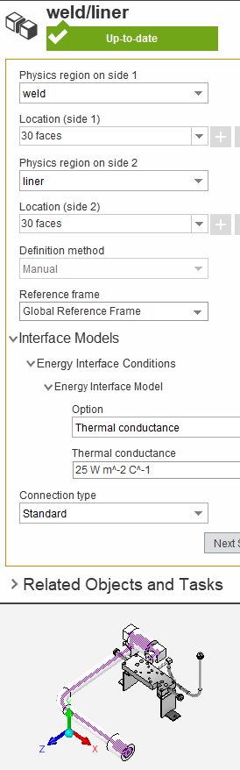
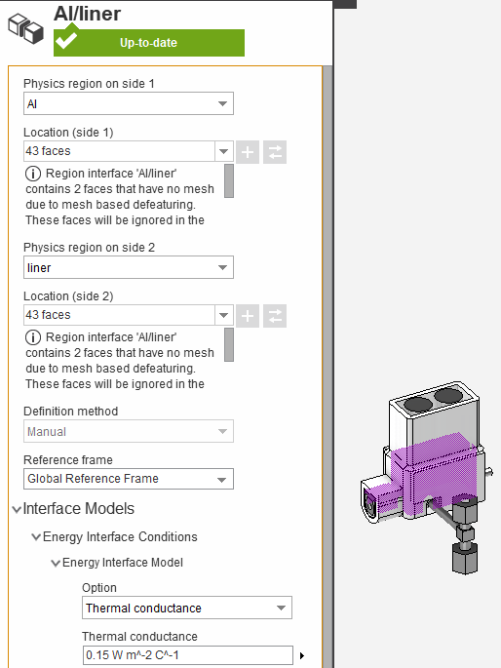
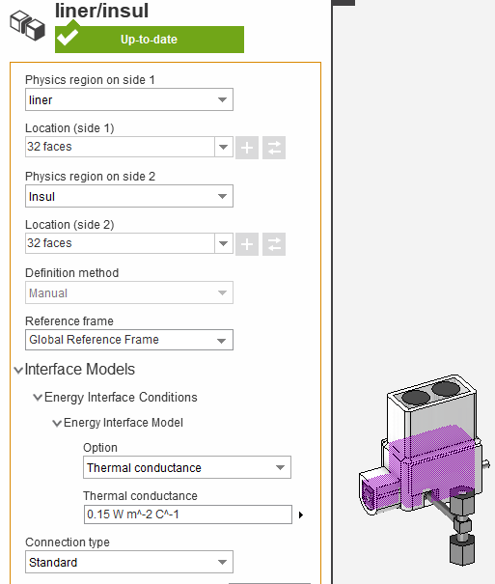
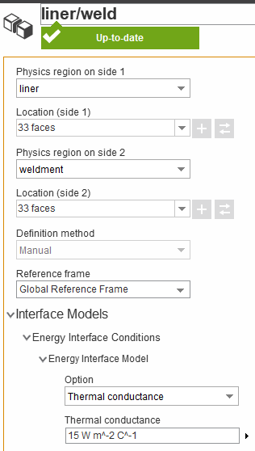
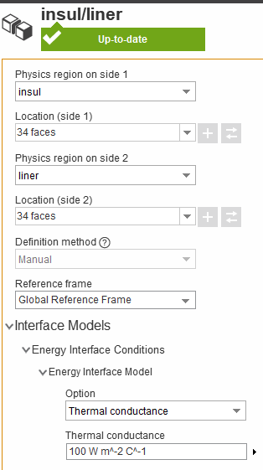
Summary of interface thermal conductance (ITC)
* h=20 W/m²-K is the natural convection coefficient in our lab, independent of type of heating element.
Wire (on pipes)
Tape (on pipes)
MICA heater
The interface thermal conductance is set as
ITC = 25 W/m²-K
between weldment and liner.
The interface thermal conductance is set as
ITC = 15 W/m²-K
between weldment and liner
ITC = 10 W/m²-K
between liner and insulation.
ITC = 10 W/m²-K
between tape and insulation.
The interface thermal conductance is set as
ITC = 0.15 W/m²-K
between liner and insulation
ITC = 0.15 W/m²-K
between MICA heaters and liner.
Air
2

Slide 3
Summary of interface thermal conductance (ITC)
Old settings
* h=20 W/m²-K is the natural convection coefficient in our lab, independent of type of heating element.
Wire (on pipes)
Tape (on pipes)
MICA heater
The interface thermal conductance is set as
ITC = 25 W/m²-K
between weldment and liner.
The interface thermal conductance is set as
ITC = 15 W/m²-K
between weldment and liner
ITC = 100 W/m²-K
between liner and insulation.
The interface thermal conductance is set as
ITC = 0.15 W/m²-K
between liner and insulation
ITC = 0.15 W/m²-K
between MICA heaters and liner.
Air
3

